Slide 1
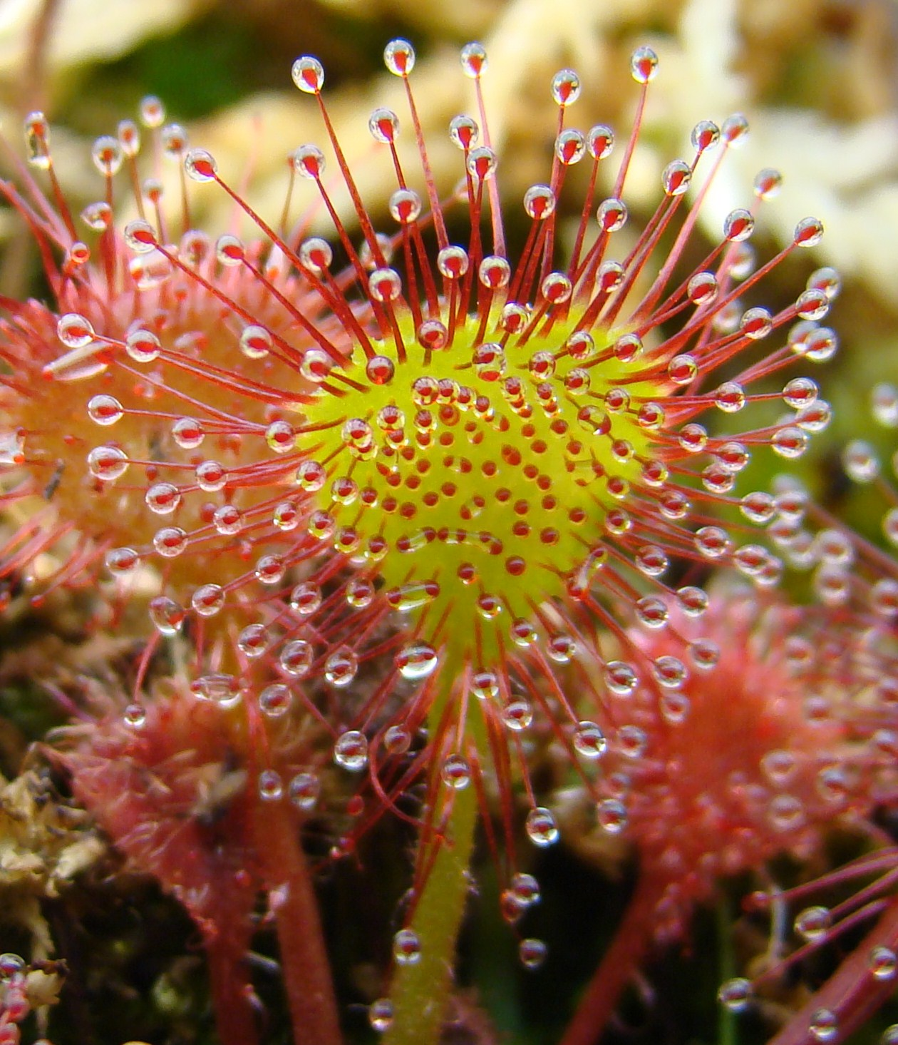
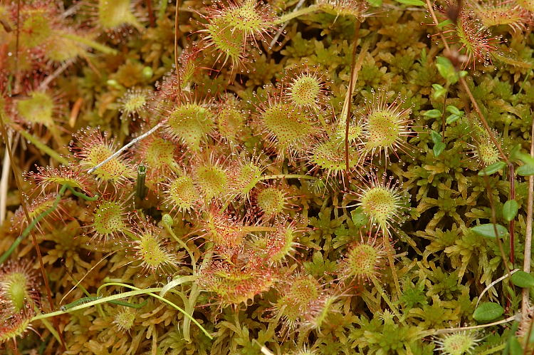
Plant of the Day Drosera rotundifolia a tiny carnivore native to bogs!
Notes:
Charles Darwin wrote Insectivorous Plants, the first well-known treatise on carnivorous plants, in 1875.^{[1]}
True carnivory is thought to have evolved independently six times in five different orders of flowering plants,^{[2][3]} and these are now represented by more than a dozen genera. These include about 630 species that attract and trap prey, produce digestive enzymes, and absorb the resulting available nutrients.^{[4]} Additionally, over 300 protocarnivorous plant species in several genera show some but not all these characteristics.

Slide 2
Big Questions
How do plants exchange genes between populations?
How do we measure gene flow?
How does the spread of a beneficial allele via gene flow differ from that of a neutral allele?

Slide 3
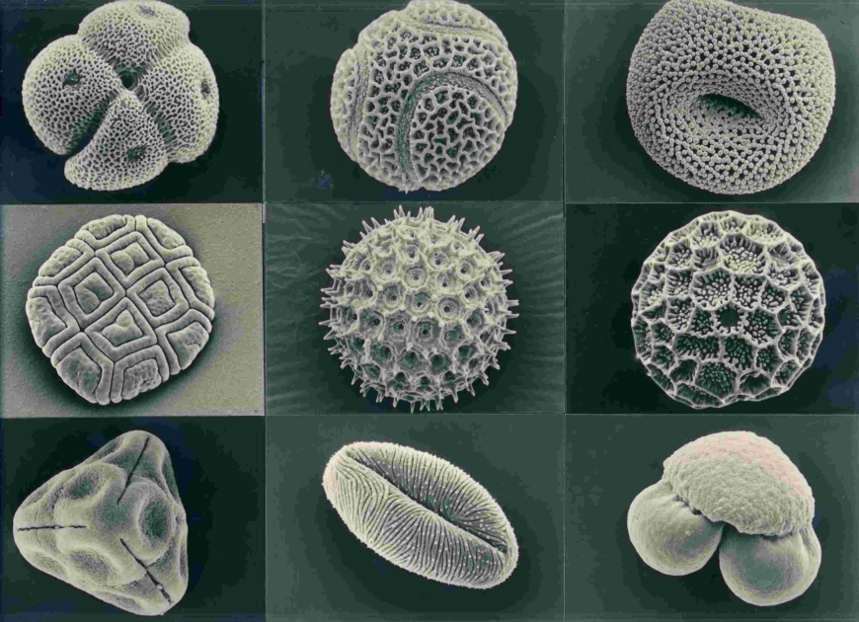
Notes:
What are these? SEM photo of nine pollen grains – very distinctive for different plant species, with characteristics inherent to their mode of dispersal. Pollen transfer is one of the ways in which gene flow may occur among plant populations. May be used for historical reconstruction analyses.

Slide 4
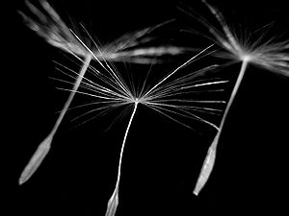
Gene flow
Gene flow is the transfer of genetic material between populations resulting from the movement of individuals (migration) or their gametes.
Gene flow may add new alleles to a population or change the frequencies of alleles already present
Gene flow connects the populations of a species, enabling them to evolve collectively (as a unit).
Reductions in gene flow may lead to speciation.
Notes:
Some of you may remember that one of the most commonly used definitions of a species, the biological species concept, uses gene flow as a key metric for determining species boundaries.

Slide 5
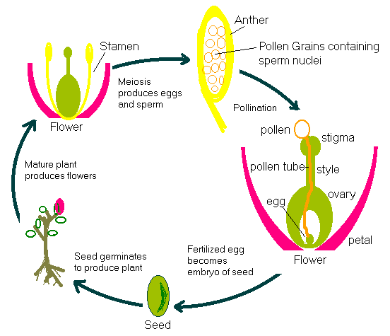
Gene flow in plants
(Seed) plants disperse their genes during two independent life cycle stages.
Pollen
dispersal
Seed
dispersal
Notes:
Pollen dispersal before fertilization, or seed dispersal after fertilization. For seed plants at least.

Slide 6
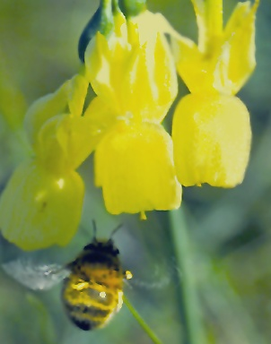
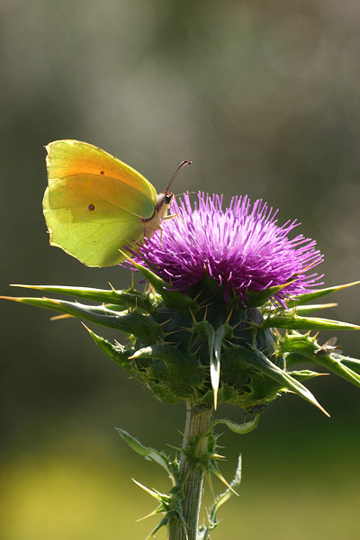
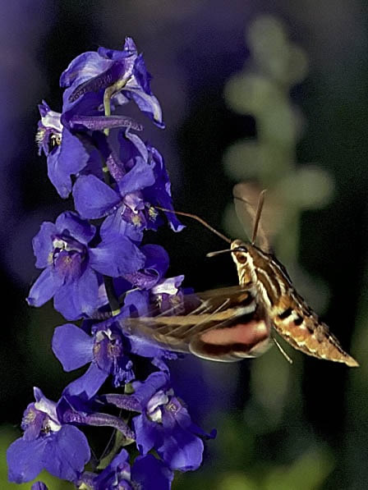
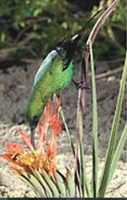
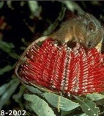
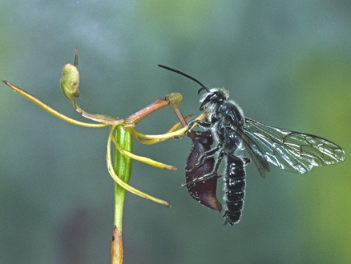
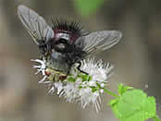
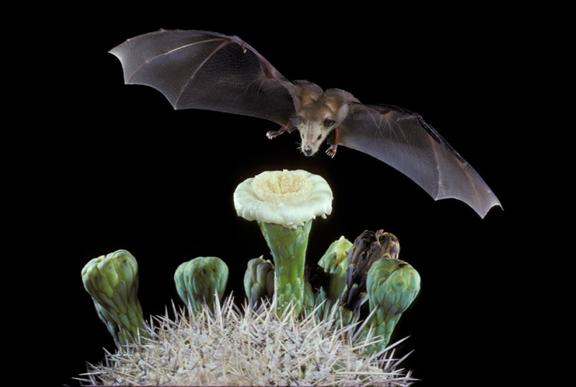
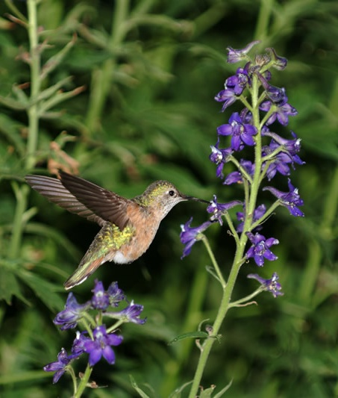
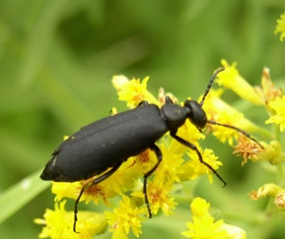
Pollen dispersal agents: biotic
Insects
Vertebrates
Hawkmoth
Sunbird
Solitary
bee
Cleopatra
butterfly
Honey possum
Long-nosed bat
Blister
beetle
Tchinid fly
Beetle
Thynnid wasp
Hummingbird
Notes:
Pollen may be dispersed with the aid of biotic agents. For example, bees, butterflies, vertebrates or other insects. Many flowering plants have specific adaptations to attract their pollinator of choice (e.g. pollination syndrome), and the pollinators in turn have coadaptations to match the plant traits. More on this in the coevolution lecture.

Slide 7
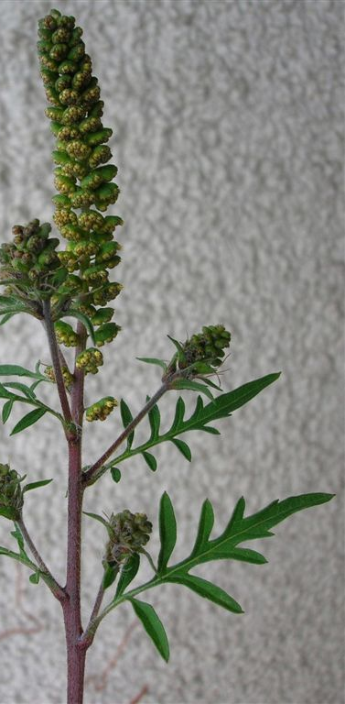
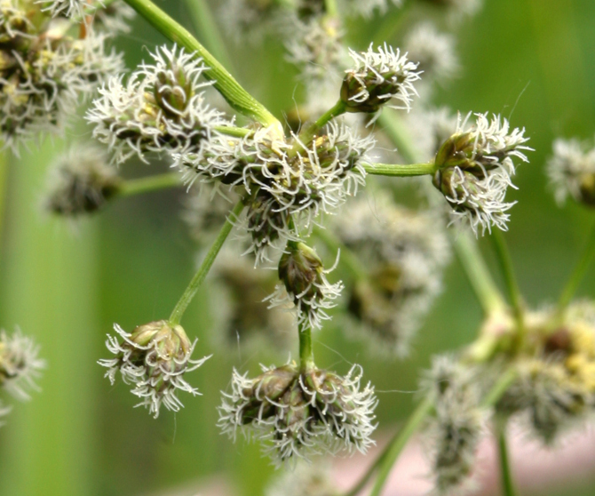
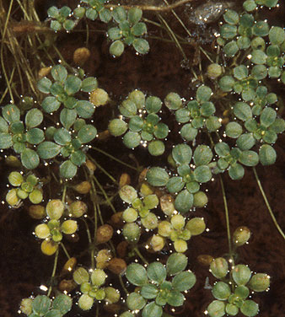
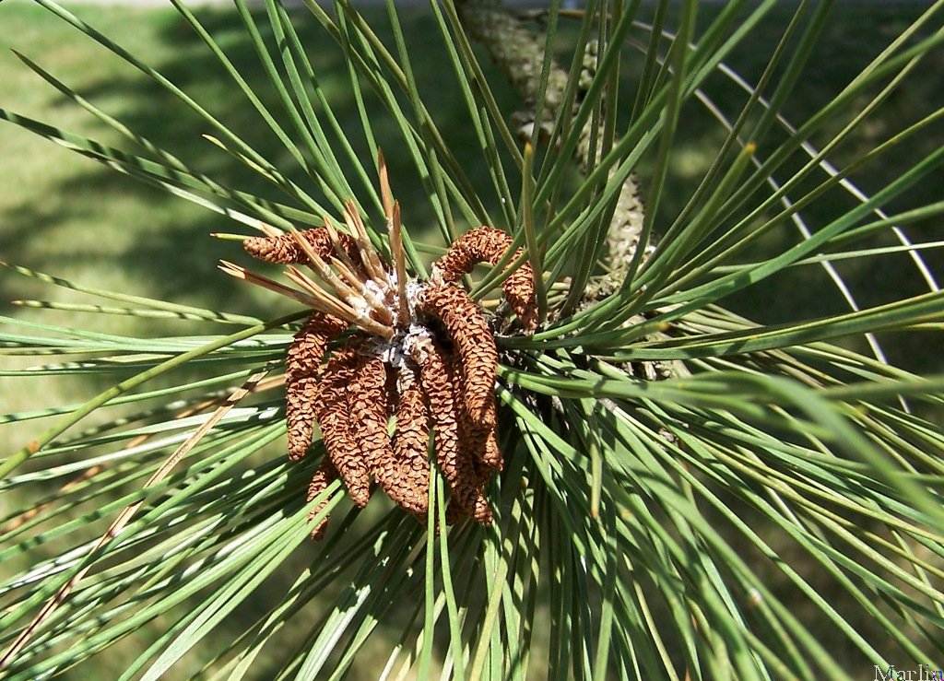
Pollen dispersal agents: abiotic
Wind
Water
Water Starwort
Scirpus microcarpus
Ponderosa pine
Ragweed
Notes:
Only 10% of flowering plants, e.g. grasses, most conifers and many deciduous trees. Abiotically pollinated species often exhibit much less showy flowers, as they have no need to attract pollinators. Though they may still have specific structures to promote cross-pollination – much lower efficiency than biotic pollination. E.g. Scirpus microcarpus, an endangered sedge (bulrush) that grows in wetlands.

Slide 8
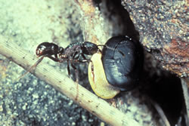
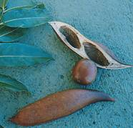
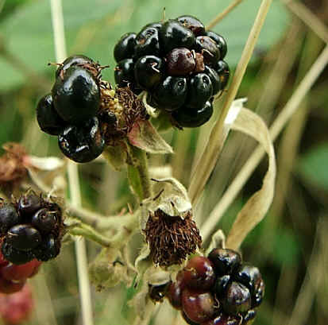
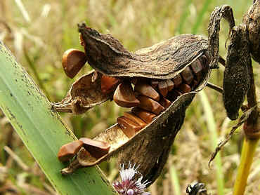
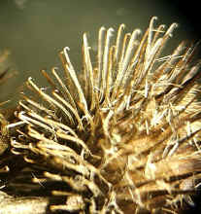
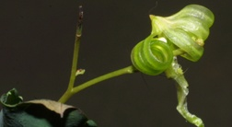
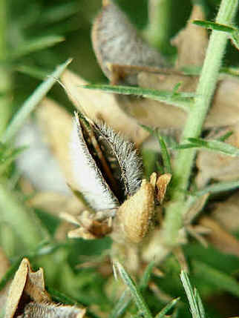
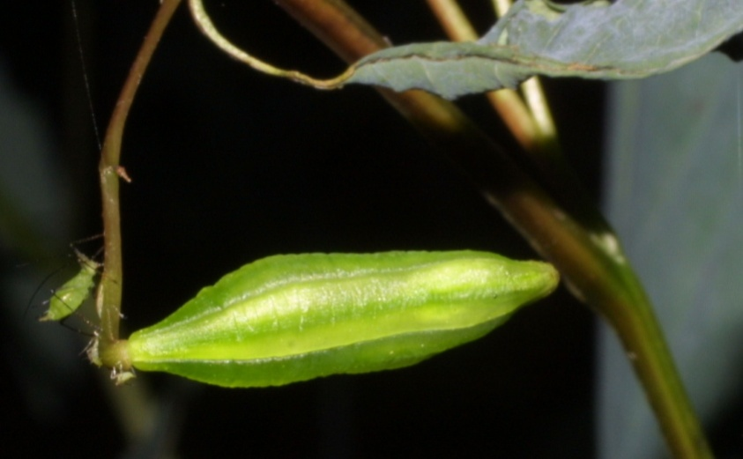
Seed dispersal agents
Animal
Water
Blackberry
Pond iris
Impatiens
Black bean
Wind
Explosive
Gorse
Dandelion
Notes:
Similarly, seeds may be dispersed biotically (e.g. by animals, who may exact a cost, for example eating the fleshy part of the fruit) or abiotically.

Slide 9
Measuring gene flow:
direct methods
(1) Observe movement of dispersal agents
Shortcomings: may e.g. underestimate dispersal because of pollen and seed carryover. Can’t tell if pollen is successfully incorporated into new population.
(2) Mark dispersing objects with dyes, paint, or radioactive tracers and monitor movement
Alternative: naturally polymorphic dispersing objects.
Shortcomings: marking may affect dispersal. Can’t tell if pollen is successfully incorporated into new population.
Notes:
Note: these methods generally apply to dispersal via pollen, but some might also apply to seeds.
May debate direct/indirect. (1) Secondary pollen carry-over is when a pollinator picks up foreign pollen on a flower, and disperses it for a second time. Gene flow of course (2)

Slide 10
Measuring gene flow:
direct methods
(3) Track unique molecular marker from source plant(s) in progeny of nearby plants
Shortcomings: Need to identify marker and genotype all potential progeny, limited to specific source.
Data from first three methods indicates that most pollen and seeds are dispersed close to source. These results suggest that gene flow rates between plant populations are very low (< 1% per gen.).
Notes:
Shortcomings for all of these methods are that they are time-consuming!! And all focus on a focal, source individual.

Slide 11
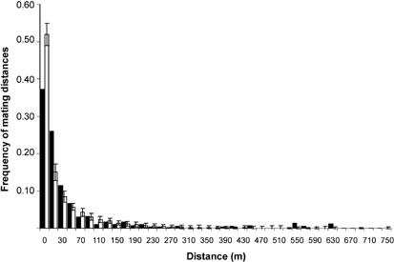
Measuring gene flow:
direct methods
(4) Parentage analyses: highly polymorphic markers are used to screen seeds to determine what fraction of seeds had fathers or mothers from outside the population.
Leptokurtic dispersal curve in Scots Pine
4.3% seeds sired by individuals outside of
the population
Robledo-Arnuncio & Gi 2005
Notes:
This method also has the shortcoming of being time-consuming and relatively expensive.

Slide 12
Measuring gene flow:
direct methods
Paternity analyses suggest that populations spatially isolated by hundreds or thousands of meters are not genetically isolated and gene flow rates often are high
(> 1% per gen.)
How to resolve this conflict?
Measuring dispersal from a source (i.e. as in Methods 1-3) misses rare, long distance dispersal events. The tails of these dispersal curves were missing.
Notes:
In contrast to results from previous direct studies of gene flow via pollen (e.g. 1-3), which found very local pollen dispersal dropping off rapidly with distance, …

Slide 13
Measuring gene flow:
direct methods
Final caveat:
All direct methods provide contemporary estimates of gene flow only, which are not necessarily related to historical gene flow levels.
Why is this, from our perspective as evolutionary biologists, problematic?
Notes:
Evolutionary biology is a very historical science, since the modern day organisms which we observe are the product of millions of years of evolution.

Slide 14
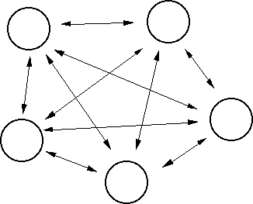
Measuring gene flow:
indirect methods
Historical gene flow can be inferred from population genetic structure (e.g. from F_{ST}). What could high F_{ST} between two populations indicate?
Statistical methods exist to relate genetic distance estimates to the parameter Nm (the average number of realized immigrants per generation).
1
4Nm +1
Wright’s F_{ST}
F_{ST} =
Island model
Notes:
So, how do we measure historical gene flow? Well, we can also measure gene flow indirectly via inference from population genetic structure. As you discussed last week, there are statistical methods used to determine how closely populations are related to one another (or the genetic distance).
Island model assumes of equal population sizes, equal contributions to migrant pool, no spatial structure, everything is at equilibrium, no selection, and no mutation all are violated in all species.

Slide 15
Measuring gene flow:
indirect methods
Nm is a critical value because it tells us how much gene flow is required to overcome the effects of genetic drift.
Nm > 4 : gene flow wins
Nm < 1 : genetic drift wins and populations diverge
Nm between 1 and 4 : neither prevails
Caveats:
Tells us about historical gene flow, not contemporary gene flow.
The real world is not like the island model (most assumptions are violated in most species).
Thus, indirect estimates must be viewed with caution.
Notes:
Island model assumes of equal population sizes, equal contributions to migrant pool, no spatial structure, everything is at equilibrium, no selection, and no mutation all are violated in all species.

Slide 16
Measuring gene flow:
indirect methods
Nm = 0.24 Nm = 0.90 Nm = 1.43
Selfers
Mixed maters
Outcrossers
Hamrick and Godt 1996
Notes:
Nonetheless, there are many calculations on Nm in the literature. As an example of the actual numbers… Indirect methods reveal differing rates of gene flow, depending on mating system.

Slide 17
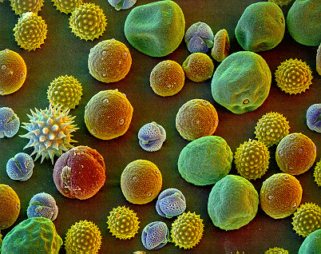
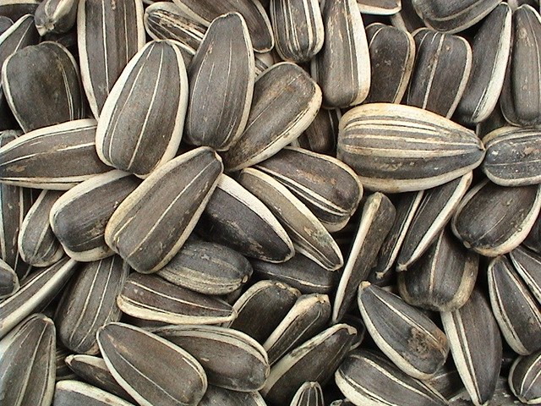
Pollen versus seed dispersal
How do these direct and indirect methods deal with the two modes of dispersal?
Notes:
Direct generally only deals with one mode at a time, and most studies focus on pollen dispersal. Indirect methods provide a combined estimate of both modes, but do not allow us to distinguish between them.

Slide 18
Pollen versus seed dispersal
Direct estimates from parentage analyses have generally documented fairly high rates of seed immigration rates, ranging from 2.1% in honey locust to 40% in Magnolias
How can we differentiate the relative contributes of gene flow from seeds versus gene flow from pollen?
We could compare levels of interpopulational differentiation (e.g. F_{ST}) for maternal versus bi-parentally inherited genes.
Notes:
So what do we know about seeds?
The maternal only Fst’s represent dispersal via seeds, whereas the nuclear genes represent both.

Slide 19
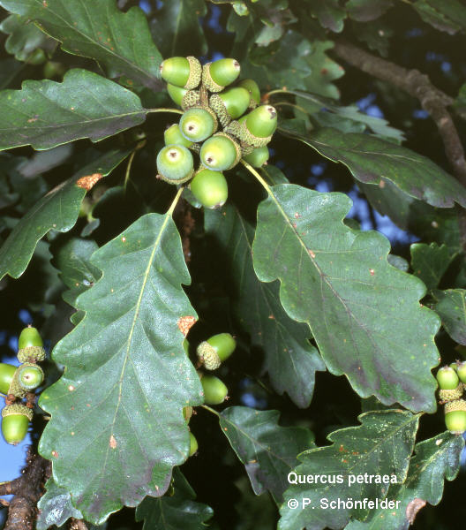
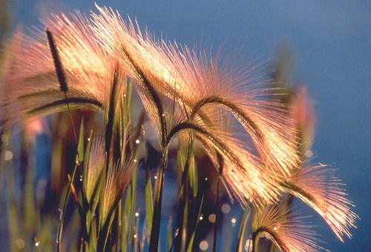
Pollen versus seed dispersal
Ratios of pollen to seed flow from indirect measures range from 4 (for selfing annual, wild barley) to 400 for wind-pollinated sessile oak.
wild barley

Slide 20
Evolution and gene flow
CONSERVATIVE ROLE (emphasized by Mayr):
Prevents differentiation due to random processes (i.e. genetic drift).
Prevents adaptive genetic differentiation
(if m > s).
CREATIVE ROLE:
Enables the spread of new mutations.
Notes:
Okay, so we’ve looked at how to measure gene flow and typical rates. Why does gene flow matter to evolutionary biologists? Gene flow has both conservative and creative roles. Theory predicts that differentiation will be prevented under certain conditions, as previously discussed.

Slide 21
Gene flow: unifying effects
How strong is gene flow in nature?
Traditional View:
Species held together by gene flow
Opposing View (Ehrlich and Raven, 1969):
Species-wide gene flow is too low
Populations are the units of evolution
Species are merely aggregates of evolving units

Slide 22
Gene flow: unifying effects
0.3
Plant
Animal
0.2
Frequency
0.1
0
0.01
0.1
1
10
100
1000
N_{e}m
What is a typical number of migrants per generation for most species? What does this tell us?
Morjan & Rieseberg 2004
Notes:
This tells us that for most species, Nm is not high enough to prevent population differentiation. There are some species for which gene flow is high enough to prevent any differentiation. Remember, though, that these values rely on the island model, which assumes no selection.

Slide 23
Gene flow: unifying effects
Think – Pair – Share
Do you expect the spread of a beneficial allele to differ from a neutral allele? How? Why?
Write down 1–2 sentences.
Discuss with a neighbor.
Report back to class.

Slide 24
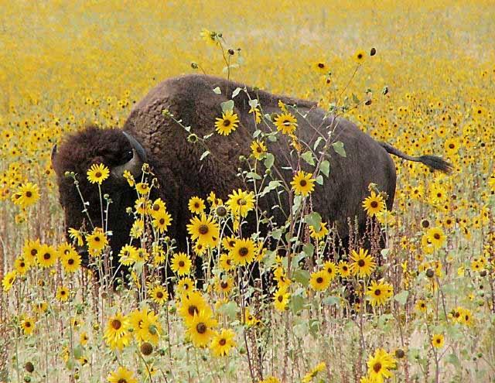
Gene flow: how favorable mutations are spread
Common sunflower, Helianthus annuus,
and its primary dispersal agent
Prehistoric range of common sunflower
Notes:
So far we have been talking mostly about neutral alleles and the role of genetic drift. The game changes once we incorporate selection.

Slide 25
Spread of mutant alleles across the range of a widespread species
Advantageous mutation
Strength of selection
S = 0.10
Number of migrants
Nm = 1
Generation
0
Near neutral mutation
Strength of selection
S = 0.0001
Number of migrants
Nm = 1
Generation
0

Slide 26
Spread of mutant alleles across the range of a widespread species
Advantageous mutation
Strength of selection
S = 0.10
Number of migrants
Nm = 1
Generation
50
Near neutral mutation
Strength of selection
S = 0.0001
Number of migrants
Nm = 1
Generation
50

Slide 27
Spread of mutant alleles across the range of a widespread species
Advantageous mutation
Strength of selection
S = 0.10
Number of migrants
Nm = 1
Generation
500
Near neutral mutation
Strength of selection
S = 0.0001
Number of migrants
Nm = 1
Generation
500

Slide 28
Spread of mutant alleles across the range of a widespread species
Near neutral mutation
Strength of selection
S = 0.0001
Number of migrants
Nm = 1
Generation
10,000

Slide 29
Spread of mutant alleles across the range of a widespread species
Near neutral mutation
Strength of selection
S = 0.0001
Number of migrants
Nm = 1
Generation
50,000

Slide 30
Spread of mutant alleles across the range of a widespread species
Near neutral mutation
Strength of selection
S = 0.0001
Number of migrants
Nm = 1
Generation
100,000

Slide 31
Spread of mutant alleles across the range of a widespread species
Near neutral mutation
Strength of selection
S = 0.0001
Number of migrants
Nm = 1
Generation
200,000

Slide 32
Time to fixation of a beneficial allele in a stepping stone model
Time to fixation of beneficial mutations
in a stepping-stone model
> 10000
> 10000
1000000
> 10000
1000 - 10000
1000 - 10000
1000 - 10000
100 - 1000
100 - 1000
100000
100 - 1000
< 100
< 100
< 100
10000
Fixation time
1000
100
10
0.1
1
0.5
1
Nm
0.001
0.01
2
0.05
0.1
10
Data from Slatkin 1976
Selection coefficient
0.2
0.45
What does this new information tell us about the unification of species via gene flow?
Notes:
Gene flow is high enough in most species to unify them through the spread of beneficial alleles, if not neutral ones.

Slide 33
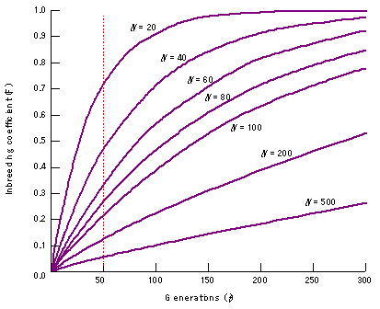
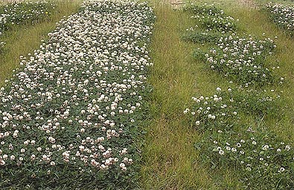
Gene flow: implications for conservation
outbred
inbred
Small populations become inbred more rapidly than large populations
Gene flow reduces inbreeding depression:
migration rates into small populations are higher than into large populations

Slide 34
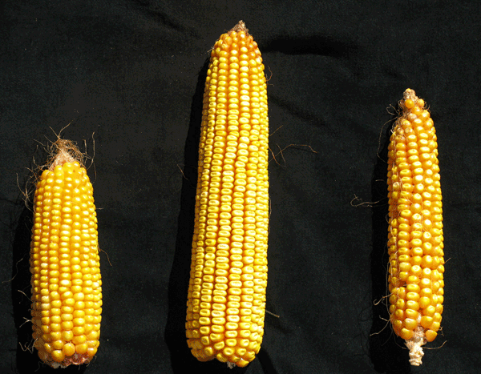
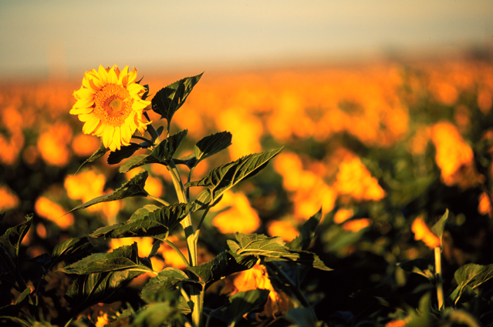
Gene flow: implications for conservation
Gene flow may create heterosis or 'hybrid vigour,' which is manifested as increased size, growth rate or other parameters resulting from the increase in heterozygosity
Hybrid corn
Hybrid sunflower

Slide 35
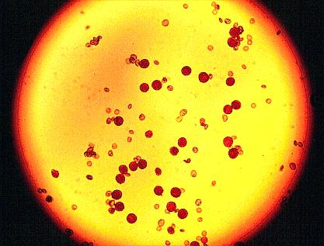
Gene flow: implications for conservation
Gene flow between species (or hybridization) may result in outbreeding depression or genetic assimilation
Reduced pollen viability in interspecific hybrids

Slide 36
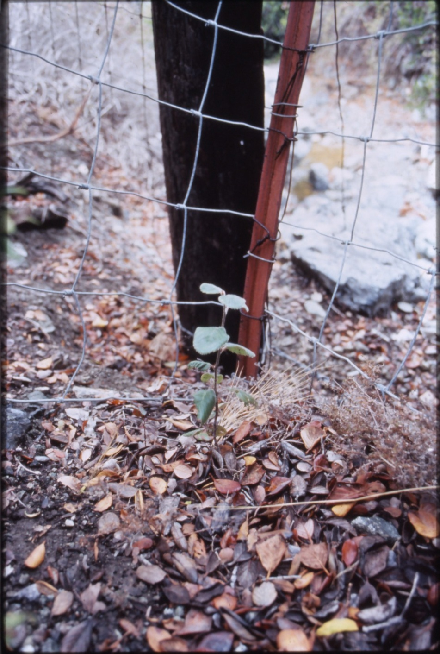
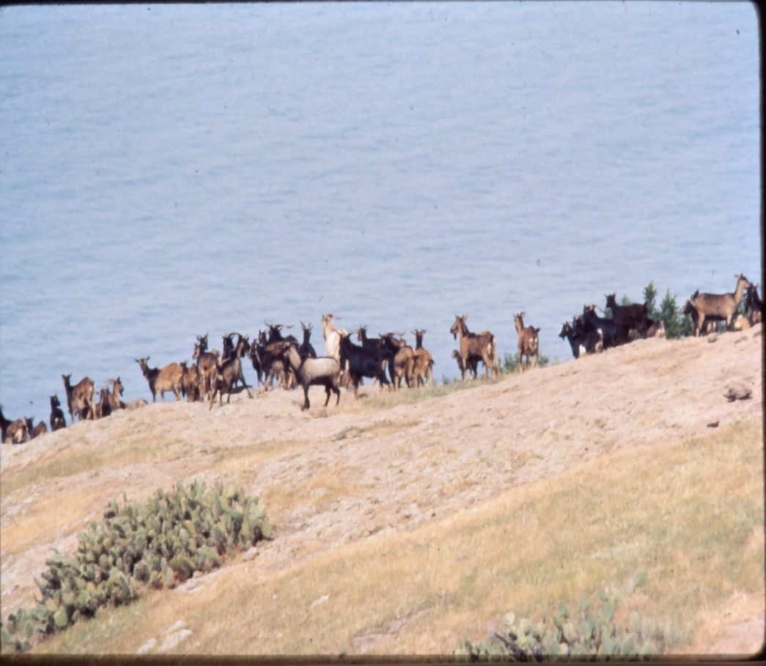
Gene flow: implications for conservation
Example of genetic assimilation:
Catalina Island Mahogany
Rieseberg et al. 1989

Slide 37
Gene flow: implications transgene escape
Gene flow from crop plants into their wild relatives may lead to the escape of engineered genes.

Slide 38
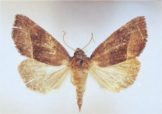
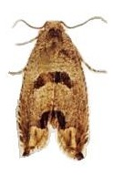
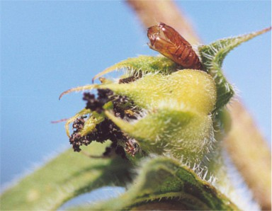
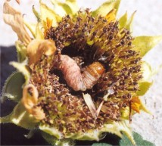
Gene flow: implications transgene escape
Bt protein Cry1Ac
toxic to Lepidopteran Insects
Plagiomimicus spumosum
(developing bud; > 50% seed loss)
Suleima helianthana
Sunflower Bud Moth (stem/developing bud)

Slide 39
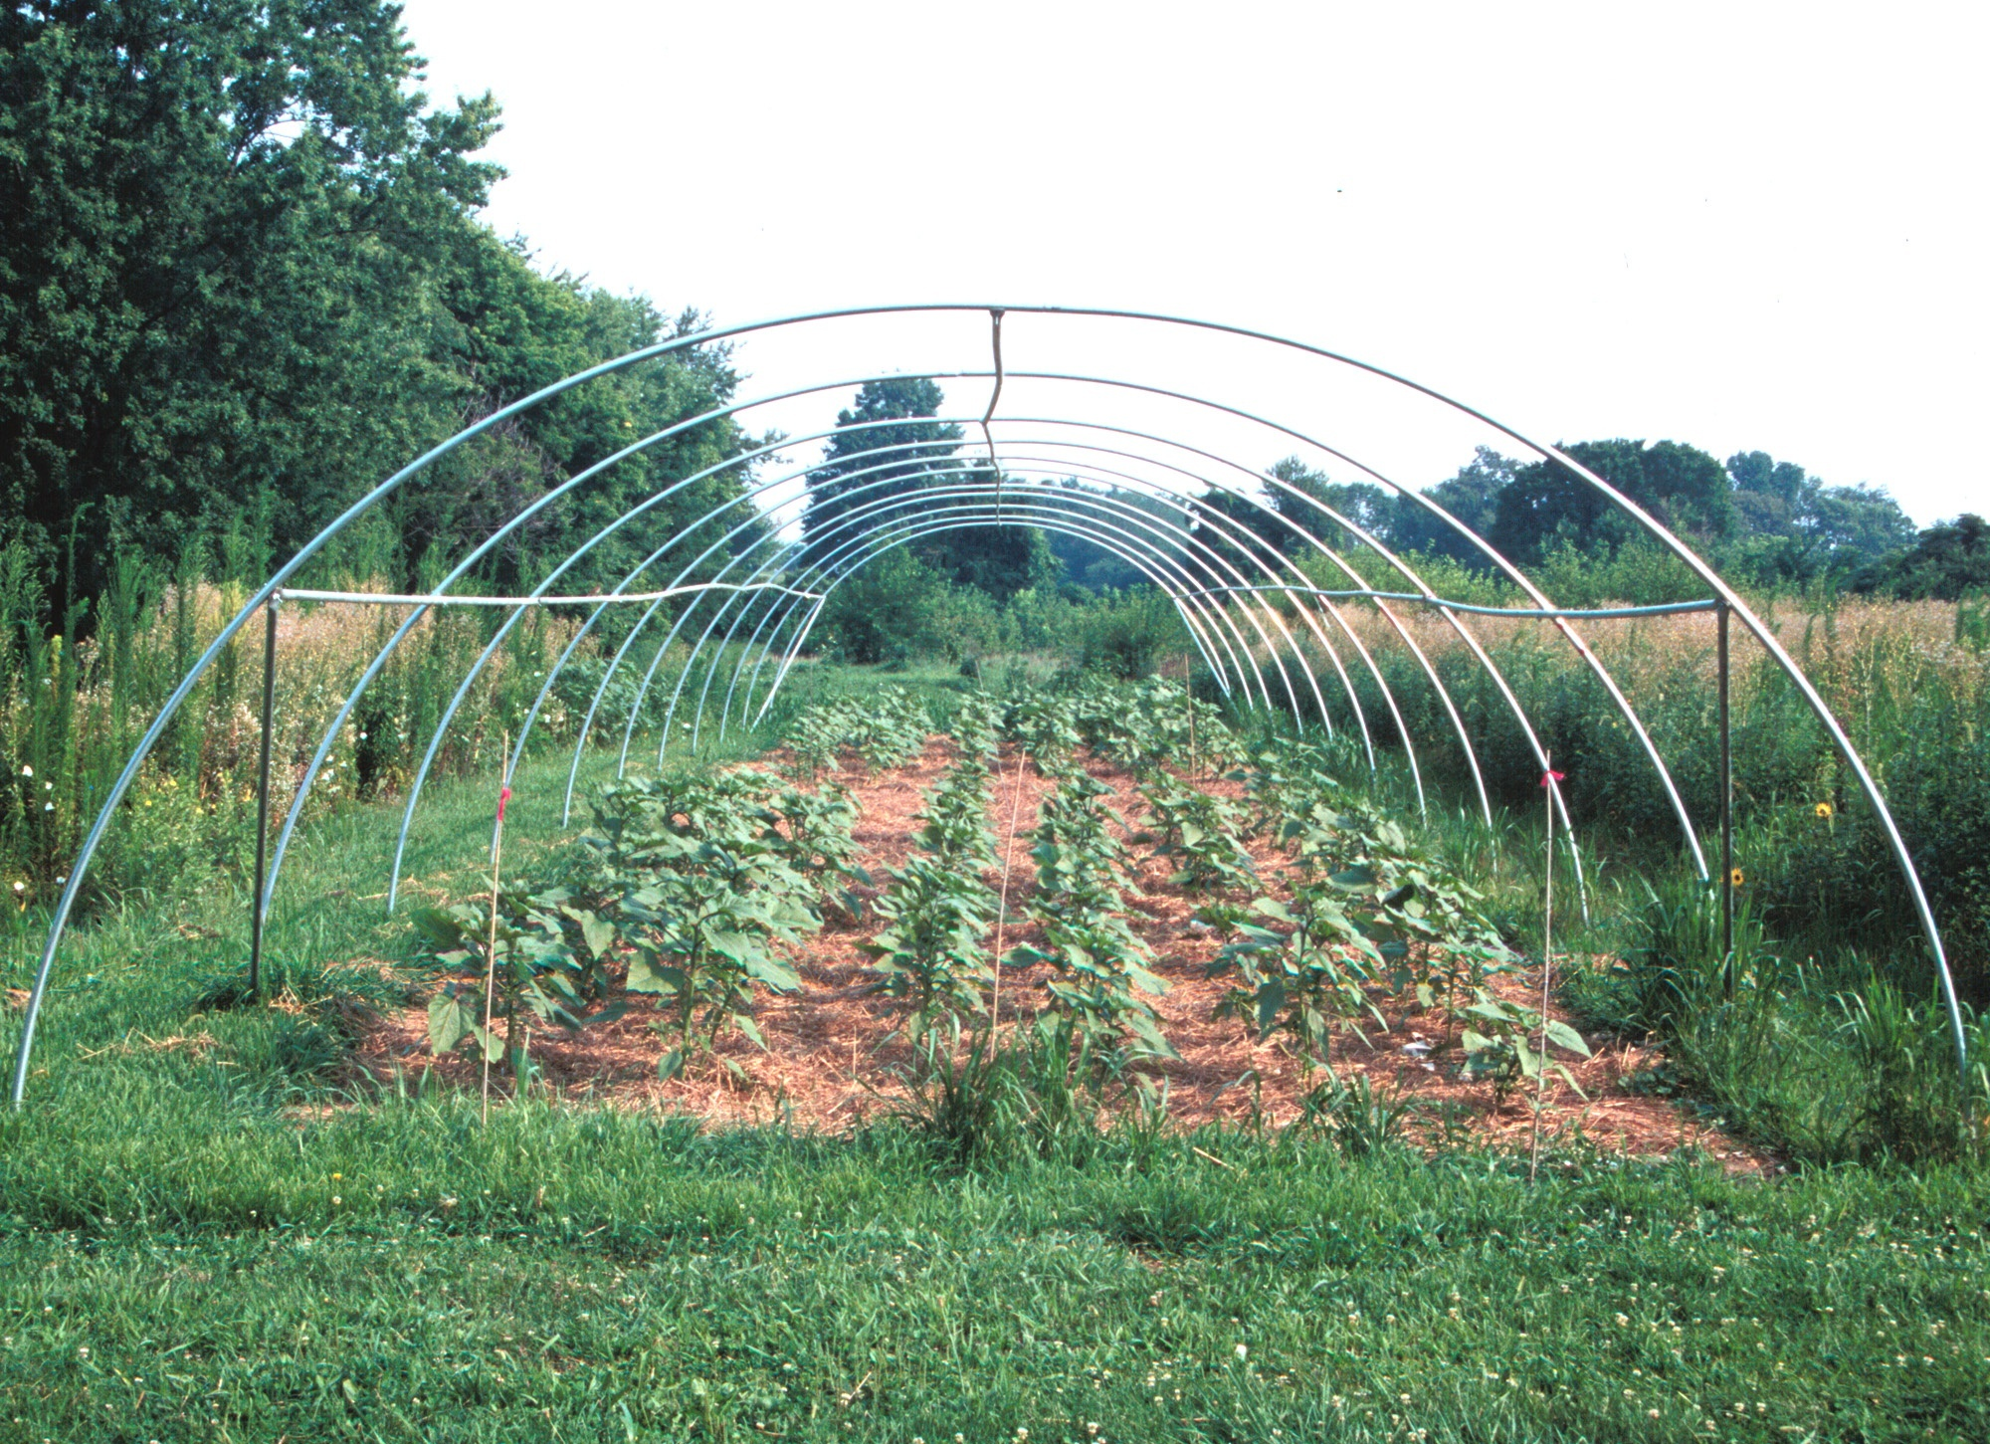
Experimental Design
backcrossed Bt transgene into wild background
planted backcross plants that segregated for transgene at two localities
compared fitness of plants with or without transgene

Slide 40
Gene flow: implications transgene escape
Cochylis
damage in Nebraska
Cochylis
damage in Colorado
0.15
0.15
RESULTS:
55% more seeds in NE 14% more seeds in CO
0.10
NS
0.10
**
0.05
**
0.05
*
0
0
Bt-/F
Bt-/S
Bt+/S
Bt-/F
Bt-/S
Bt+/S
Seeds per plant in Nebraska Seeds per plant in Colorado
1200
2400
NS
800
*
1600
*
**
400
800
0
0
Snow et al. 2003

Slide 41
Transgenes: conclusions
Bt transgenes are highly advantageous and will spread rapidly into wild sunflower populations.
Decisions on environmental release should be made on a case-by-case basis.
Consideration of the potential ecological impacts should be made.

Slide 42
Unanswered Questions
Is gene flow primarily conservative or creative?
Are species tied together by gene flow as a single ‘evolutionary unit’?
How often does gene flow impede versus assist adaptation?

